Slide 1
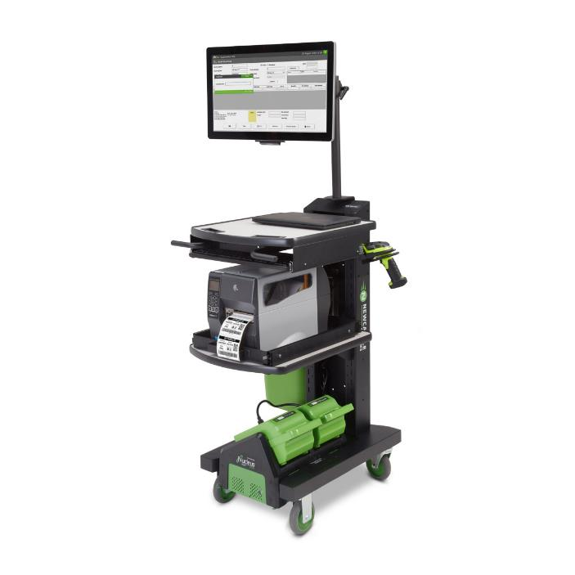

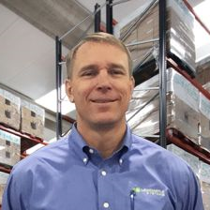
Mobile Power 101: Opening the Window of Opportunity
Christine Wheeler Marketing Director
Kevin Ledversis Sales Director
May 20, 2021, 2pm EST

Slide 2

Welcome Friends!
1
Welcome – the Goals for You Today
2
2021 Warehouse Challenges
3
How to Help Your Customers Solve Them
4
(3) Proven Opps You Can’t Ignore
5
Your Questions

Slide 3

POLL Question I
Poll Question
POLL QUESTION
NUMBER 1
Are you now visiting your customers in person?
Yes / No

Slide 4

We Want Our Things Fast
US eCommerce Penetration
30%
25-30%
25%
20%
16.0%
14.4%
15%
13.2%
11.8%
10.7%
10%
8.8%
9.7%
8.0%
6.4%
7.2%
5%
0%
2010
2011
2012
2013
2014
2015
2016
2017
2018
2019
2020E

Slide 5
Ecommerce - 2021
For 2021, US retail ecommerce sales forecasted to…
    Grow 13.7% reaching $908.73B
    Make up 15.5% of $5.856T in total retail sales
Which product categories will grow the fastest in 2021?
    Apparel & accessories at 18.9%
    Food & beverage at 18.1%
Which categories are most established in ecommerce?
    Books/music/video at 69.1%
    Computer/consumer electronics at 53.2%

Slide 6
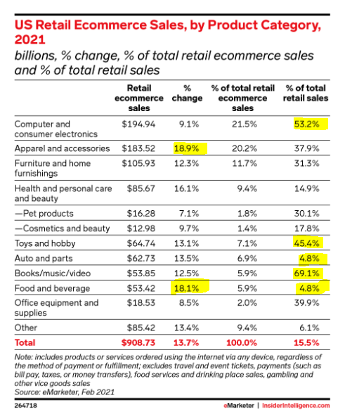
We Want Our Things Fast

Slide 7
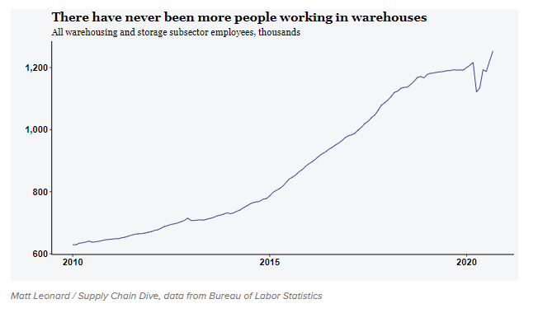
To Support E-Commerce….
Over 1.25M warehouse workers

Slide 8

To Support E-Commerce….
28,500 new warehouses needed by 2025
Increased automation with robots - move inventory, assist pickers, etc.
But receiving, pick/pack and shipping are still labor-intensive processes requiring more warehouse workers

Slide 9
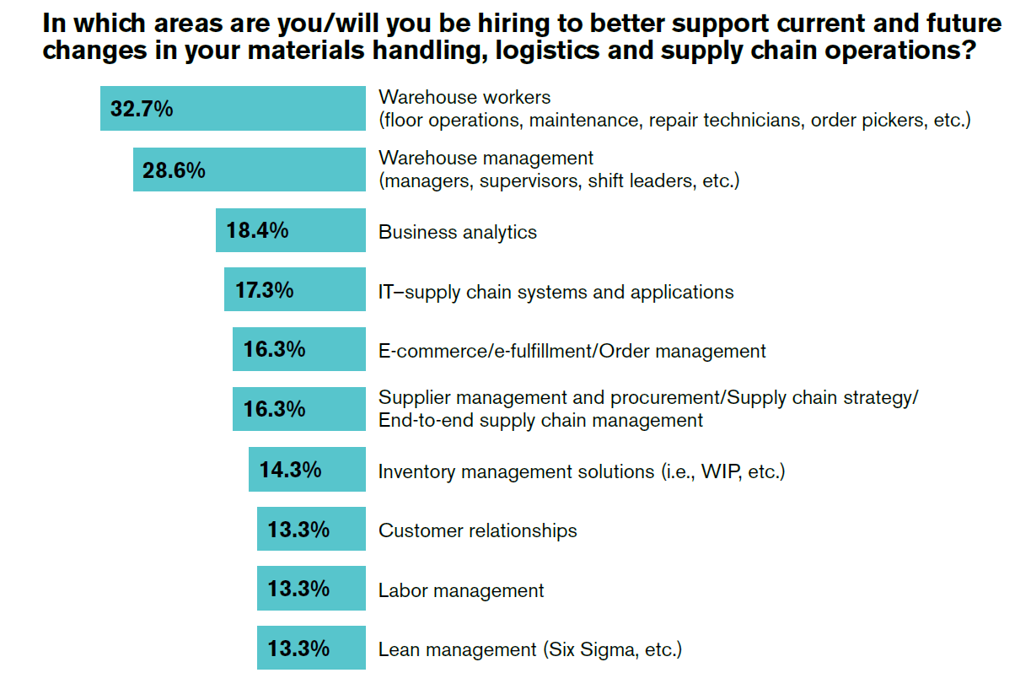
To Support E-Commerce….

Slide 10
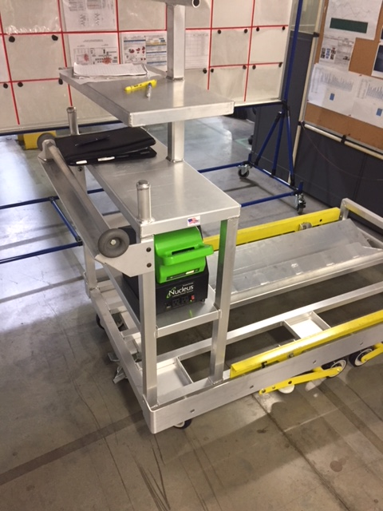

What Does This Tell Us?
Labor & Capacity Challenges =
Opportunity for YOU to help your customers succeed

Slide 11
Poll Question
POLL QUESTION
NUMBER 2
Will you be adding robots to your product offering?
Yes / No / Maybe

Slide 12
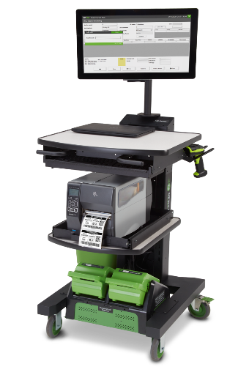
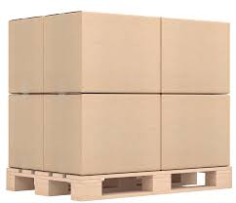
A Serious Problem Most Do NOT See
Millions of Miles, Hours & Dollars Spent Walking
A
B

Slide 13
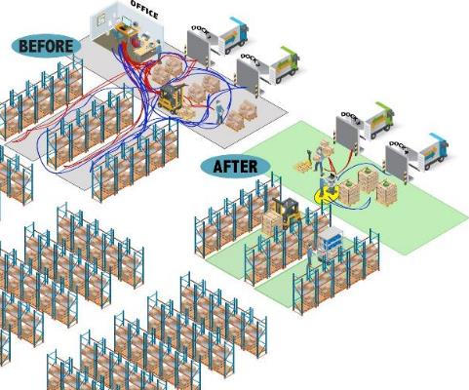
Identifying Prospects
Business is Up
Struggling with Labor
OT >12% and Turnover >40%
Dock Congestion
Batch Printing
Walking
Metrics/KPI’s

Slide 14
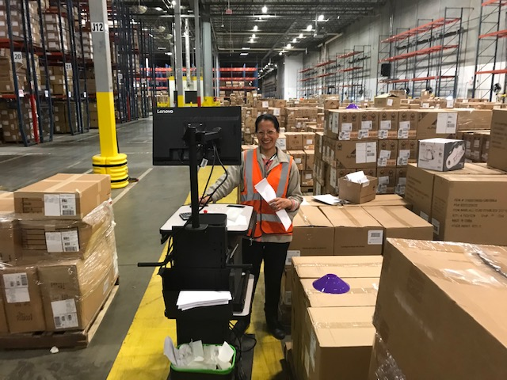
Opportunity #1 - Inbound/Returns
Congestion/Flow
Breaking Pallets
Batch Print and Carry
Dock to Stock Over 8 Hrs
50%+ Increases w/Mobile Power
Lines Received per HR
  Best in Class: >60
  Major Opportunity: <7

Slide 15
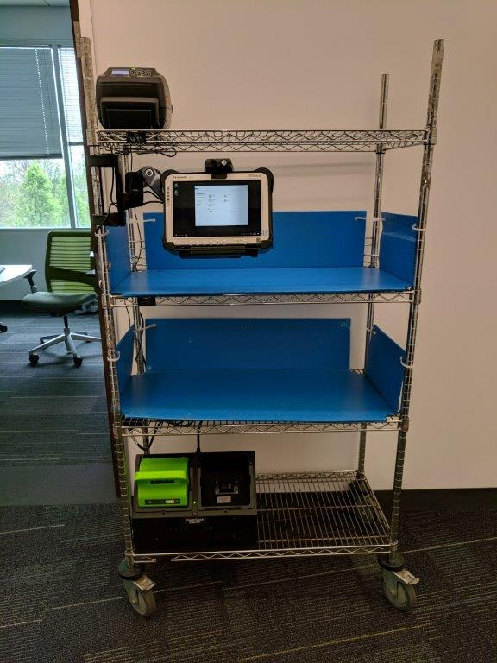
Opportunity #2 - Picking
Single Line Items
Paper Based
Paper to Screen
High Velocity Pick Zone (80/20)
30%+ Increases with Mobile Power
Orders Picked/Shipped per HR
  Best in Class: >38
  Major Opportunity: <3

Slide 16
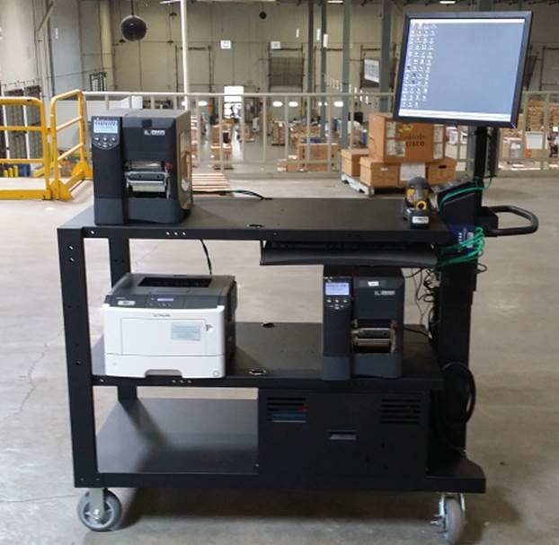
Opportunity #3 - Outbound Labeling / Paperwork
Congestion/Flow
Order Speed Demands 2 hrs
Lots of Parcels (Each’s)
Ecommerce Sales
Paperwork Printed in Bulk
90% Rduction in Labeling Errors w/Mobile Power
Orders Shipped with Correct Documents
  Best in Class: >99.8% Major Opportunity: <94%

Slide 17
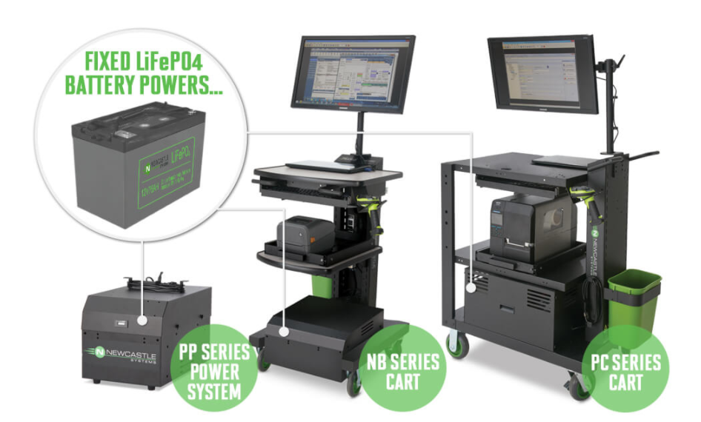
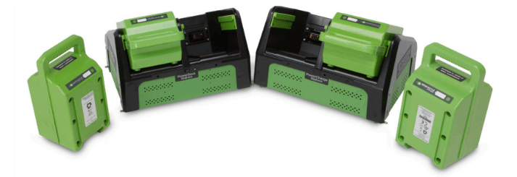
**BONUS** Opportunity #4
Retrofit old SLA Battery Systems with Swappable or Fixed Lithium Power Systems
Light-weight
long battery life
24 / 7 operation =
ideal for ecommerce

Slide 18
Improve Win Rates
30% of IT Proposals get a YES/NO
They don’t see value
They don’t understand impact
They don’t know how to pay for it
Understand the Process
Problem Solve – Fingerprints/Footprints
Technology Offers Improvement
+ Metrics
ROI

Slide 19
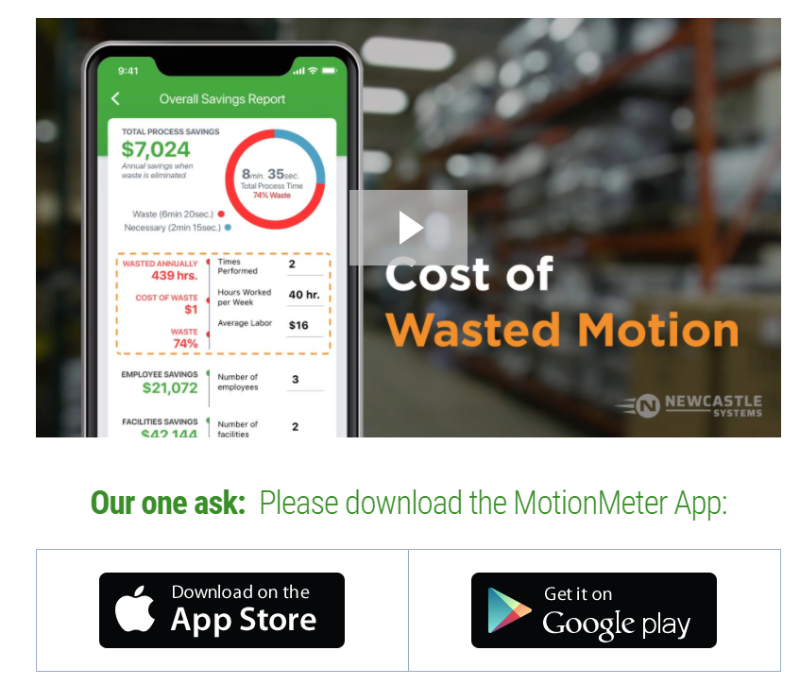
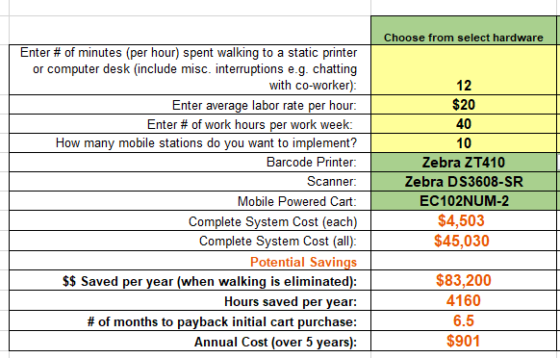
SHOW THE MATH
IT
IT
OPS
https://www.newcastlesys.com/motionmeter-reseller
OPS
CFO
IT
https://www.newcastlesys.com/resellers/training-tools/roi-calculators
Notes:
- Switch Screen Share to Calculator from Here.

Slide 20

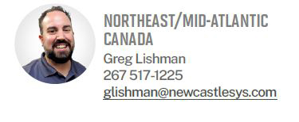
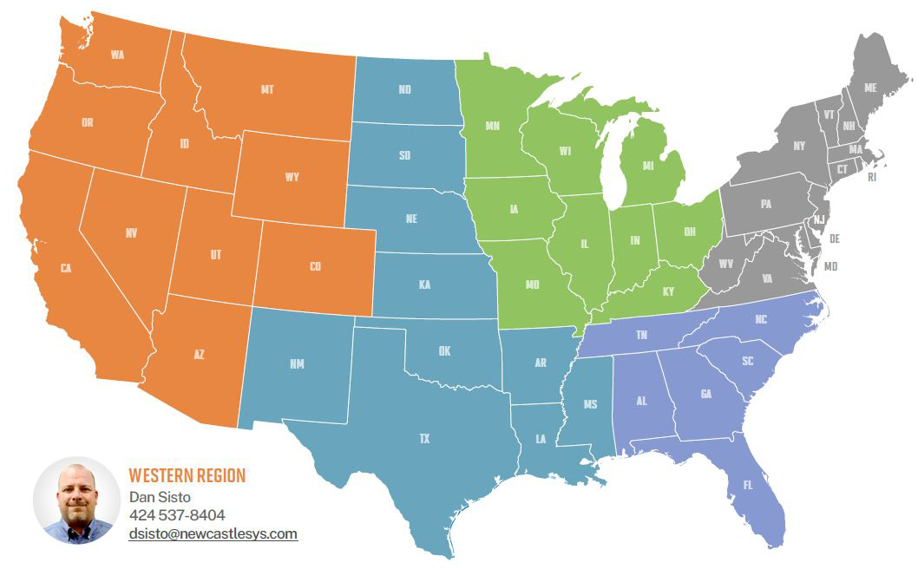

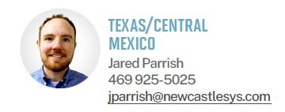
RSMs – Here to Support YOU
Notes:
- Switch Screen Share to Calculator from Here.

Slide 21
YOUR QUESTIONS

