Slide 1
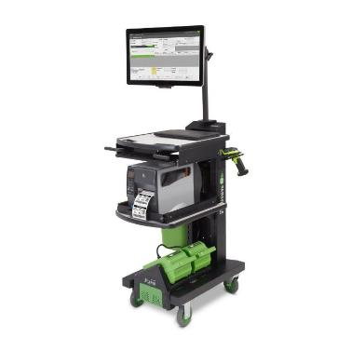
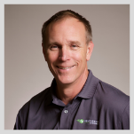
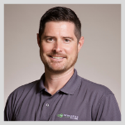
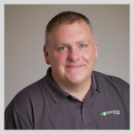
Mobile Power 101: Break Through to 2022
Kevin Ledversis
Director of Sales
Drew Arnold
Midwest Regional
Sales Manager
Pat Hoskins
Strategic Accounts
Manager
February 24, 2022, 2pm EST

Slide 2

Welcome Friends!
1
Welcome – the Goals for You Today
2
Top Lesson from 2021
3
Your Right-Now Opportunity for eCommerce & AIDC
4
You’ll Sell More with ABM (Account Based Marketing)
5
Your Questions

Slide 3

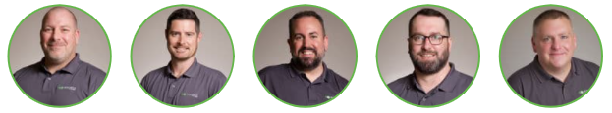
Thanks to our Resellers
          More Tools, More Lead Gen, Marketing Made Easy, CAM
Connect with Regional and Strategic Reps
AIDC Influencers
Best Kept Secret

Slide 4
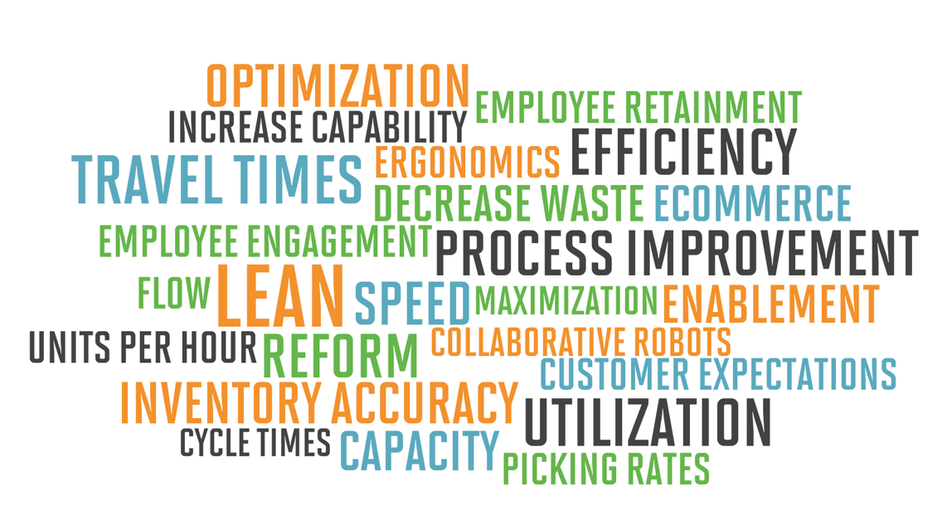
Focus & Outputs
Manufacturing 3PL’s Retail DC Wholesale Distribution

Slide 5
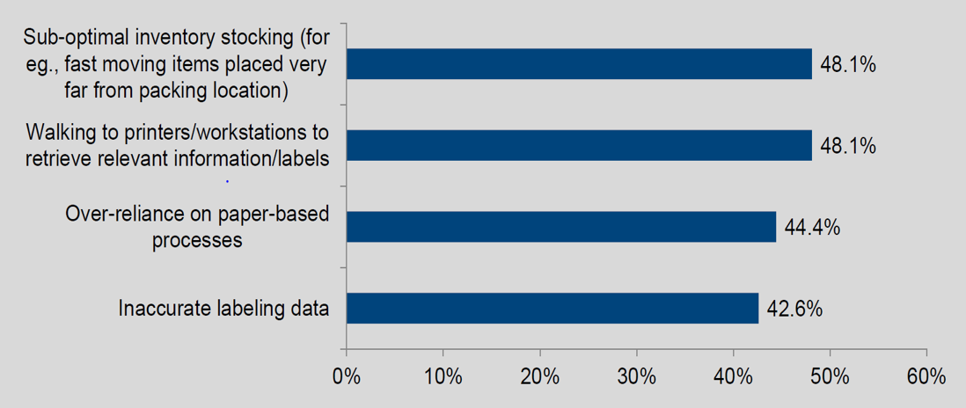



VDC Research – Workflow Inefficiencies

Slide 6
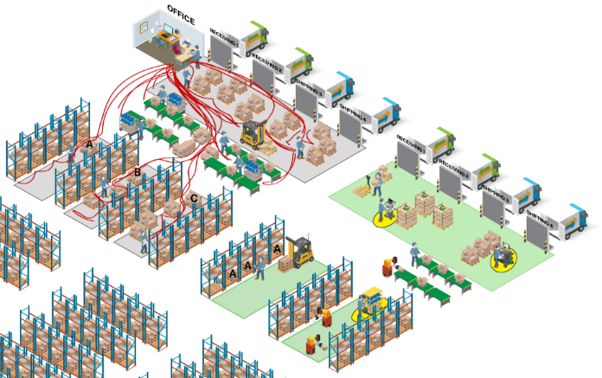
Math Metrics and ROI
Potential Best-in-Class Metrics
with Mobility
Internal order cycle time: < 2 hours
Dock-to-stock cycle time: < 2.14 hours
Inventory count accuracy: >= 99.9%
Orders picked & shipped per hour: > 35
Orders shipped with correct docs: >= 99.8%
Annual workforce turnover: < 4.8%

Slide 7
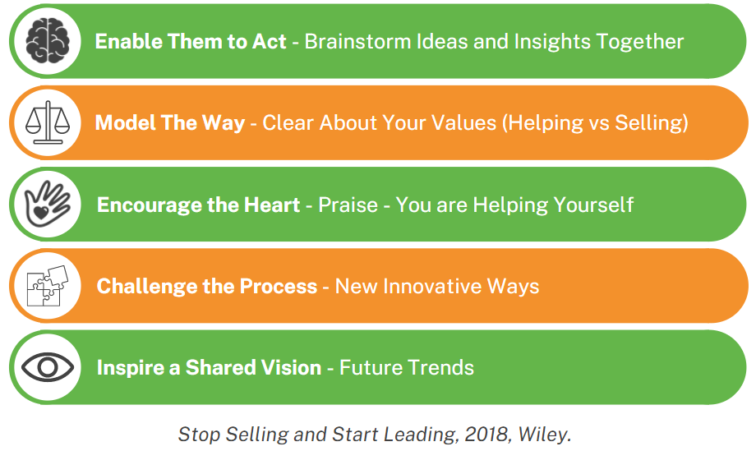
What B2B Buyers Want - John Westman

Slide 8

E-commerce Trends
Moving Forward:
US 2021 $908B 2024 $1.5T
Global 2021 $4.8T 2024 $6.5T
B2B bigger than B2C ECommerce
Growth:
2020 ︎⇧33%
2021 ⇧17%
Source- eMarketer & Statista

Slide 9

E-commerce Challenges
Single Line = More Orders
Labor – Intensive/Shortage
Increased Costs
Accuracy
Returns – Reverse Logistics
Inventory
Consumer Expectations
Last Mile Delivery

Slide 10
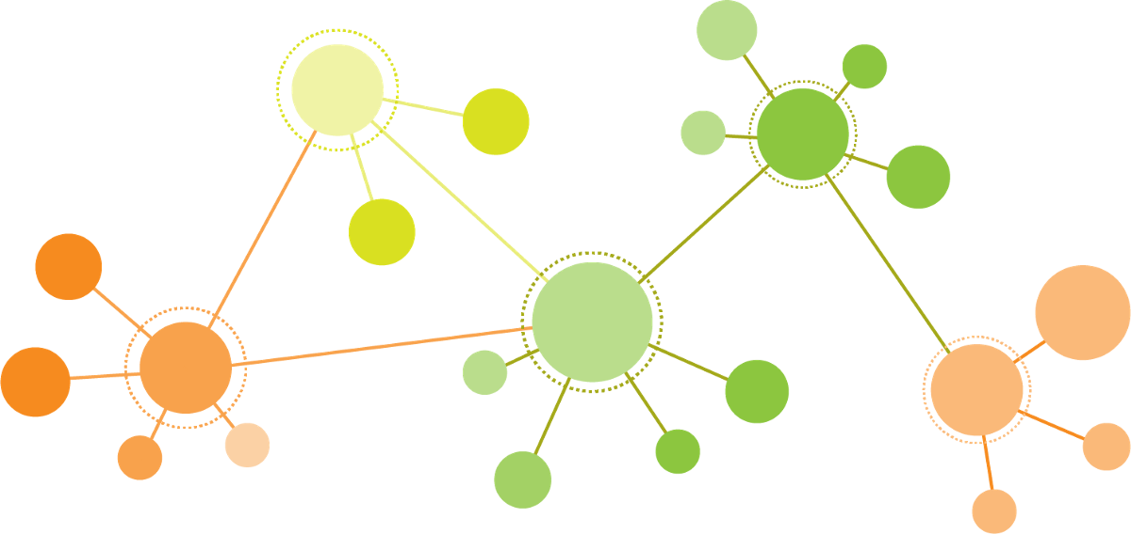
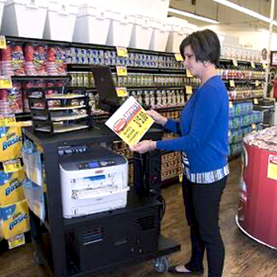
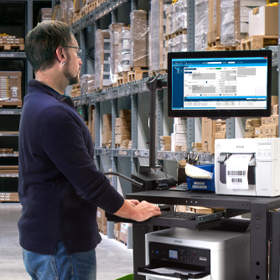
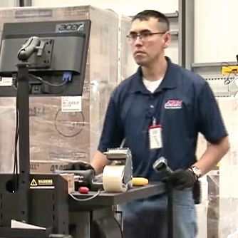
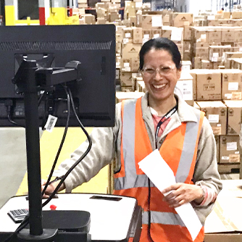
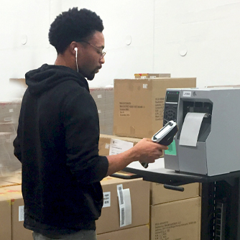
VAR Opportunity
MOBILITY
Low Hanging Fruit
More Efficient
Maximize
Wifi Usage
LEAN
Waste Reduction
5S
  SHOWCASE ROI EARLY

Slide 11
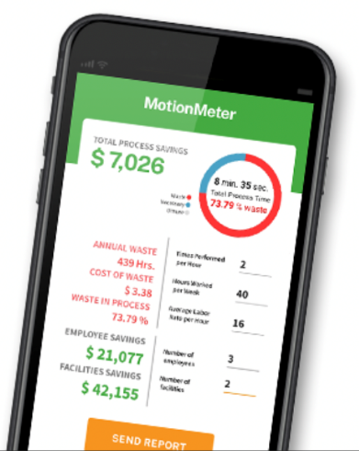
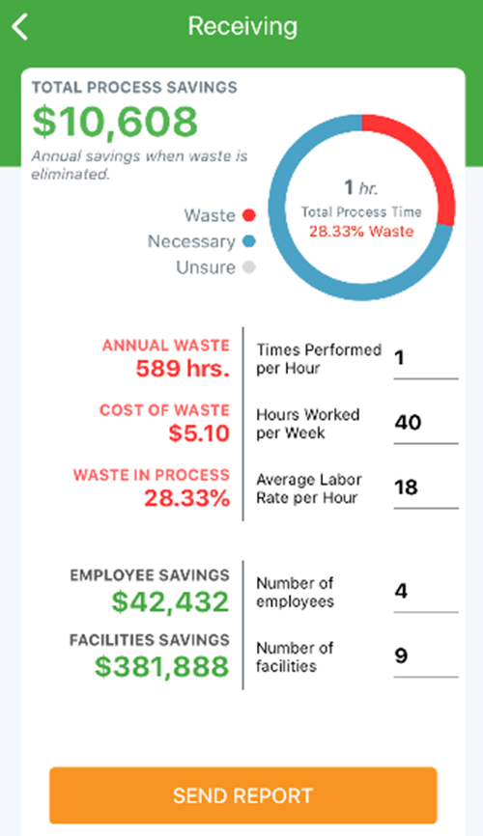
Fast ROI
Waste: 17 minutes/hour
Hourly Rate: $18
Hours per Week:40
Cart: $3,300
ROI: <4 months
Hours Saved: 589/person
Savings: $10,608/person

Slide 12
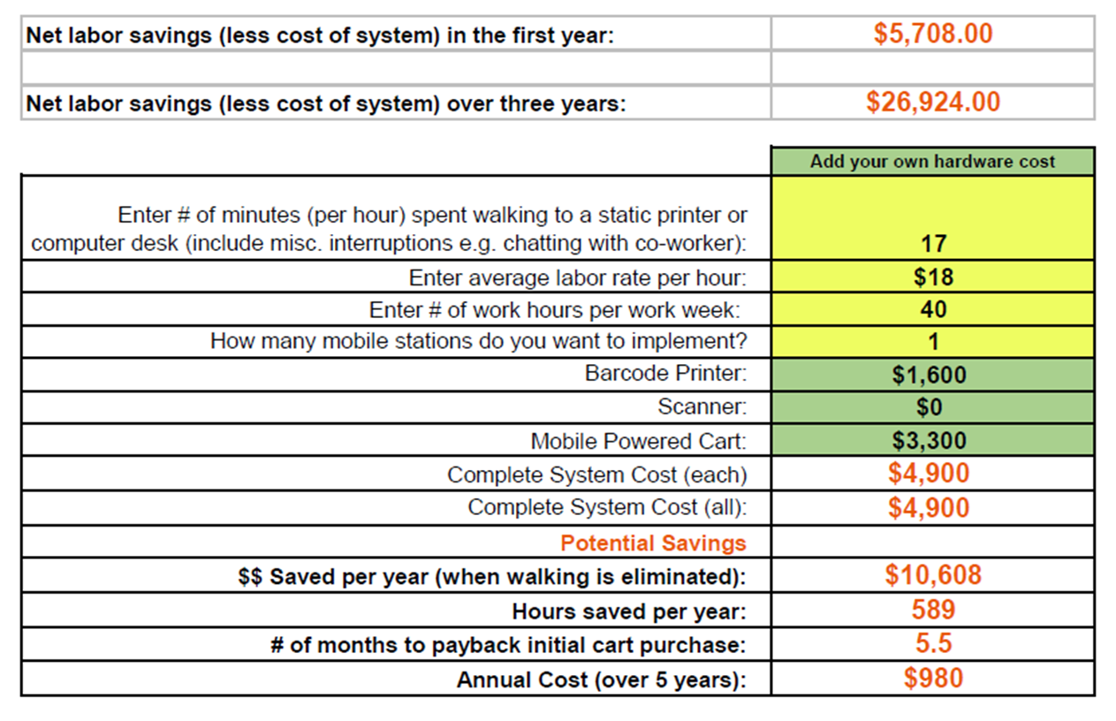
So What? How to Leverage ROI
“All-in-one bundle”
Use MPW ROI to justify
Refresh legacy equipment

Slide 13
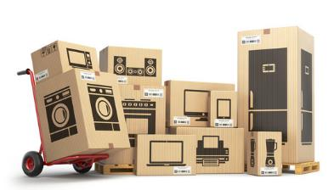
Top Appliance Co. – Big Box Shipping
Before
  Batch Printing
  Legacy Printers
  Walking from Office
  Searching & Applying
  Mislabels
  Slow
  Appliances mis-shipped
After
  1:1 Printing
  Printing at pallets
  No more searching
  No mislabels
  Fast
  Appliances shipped correctly
  New ZT411’s & Epson Workforce Pro
  59 carts - 2 hours a Shift (118 Hrs/Shift)

Slide 14
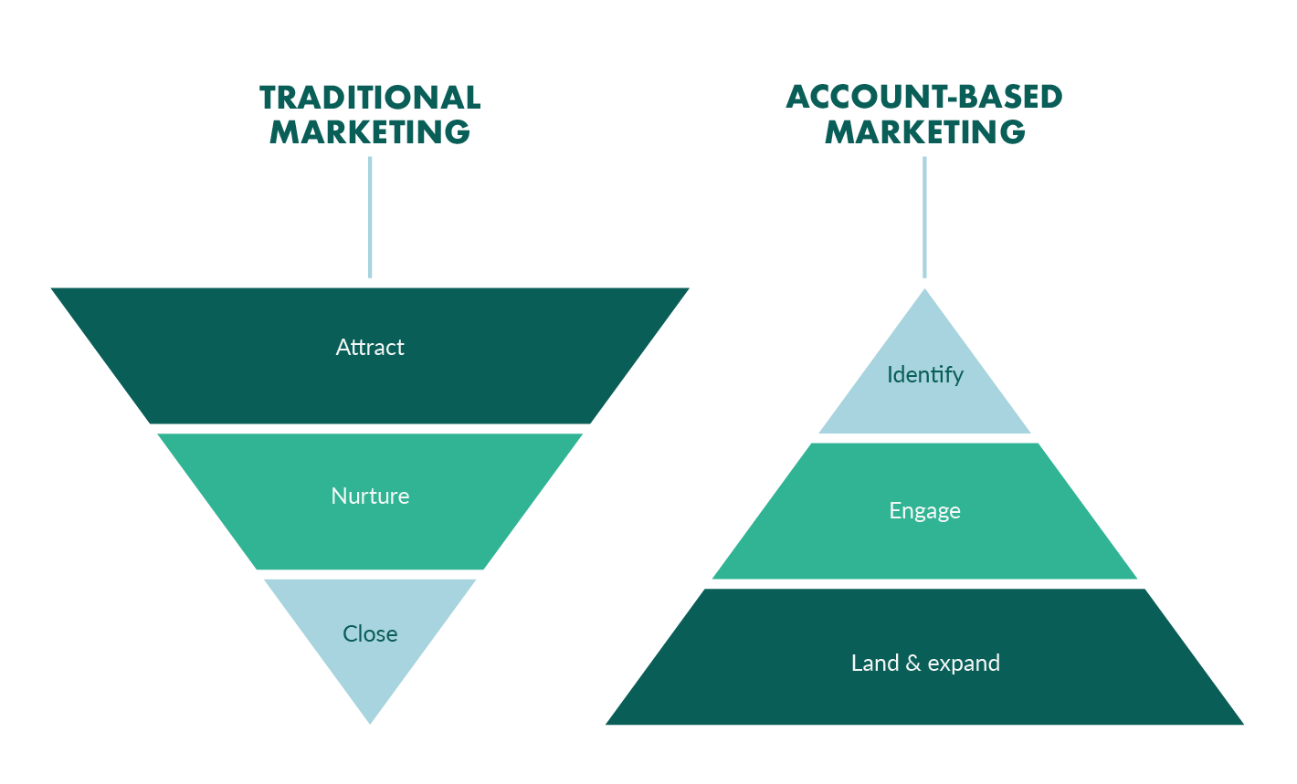
What is Account Based Marketing?
Enterprise-wide sales & marketing effort focused on key stakeholders of large accounts
Series of coordinated value touches, targeting the vertical of the company and role of individual
Communicates a high value offering and timely business value that compels a prospect to engage
Utilizes social media, email, partner efforts & sales touches to drive engagements
Source- eMarketer & Statista

Slide 15

Why ABM is Critical to Success in 2022?
70% of reps cite access to stakeholders as primary challenge*
43% of buyers prefer rep free buying*
Buyers only spend 17% of research time with vendors during buying cycle*
Need to create enterprise-wide need realization with key stakeholders (DUF’s & Influencers)
Lock out competition
              * Gartner, Inc.
"The significant problems we face cannot be solved at the same level of thinking we were at when we created them.”…Albert Einstein

Slide 16
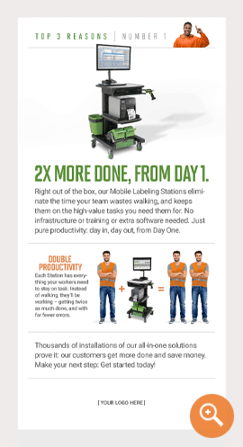
Value for our Partners
Opportunity size is enormous
Drives device volume (every cart requires devices)
Creates new audience for broader offerings
Drives new use-cases with hidden prospects
Makes us consultative business partner
Customizable marketing tools make it easy (we have a great story to tell)

Slide 17

Results So Far (in 7 weeks)
New opportunity for 46 carts with retailer
First cart sale to multi-national food manufacturer
Engaged with leader of medical devices for global standardization of processes
Identified new opportunities with several reseller partners for new applications and new stakeholders within their existing accounts

Slide 18
Contact Us Anytime
Kevin Ledversis
Director of Sales
P: 978-882-1017
kledversis@newcastlesys.com
Drew Arnold
Midwest Regional Sales Manager
P: 317-997-2969
darnold@newcastlesys.com
Pat Hoskins
Strategic Accounts Manager
P: 706-809-7794
phoskins@newcastlesys.com
All referenced sales tools can be accessed in our Reseller Portal:
https://www.newcastlesys.com/resellers

Slide 19


YOUR QUESTIONS

