Slide 1
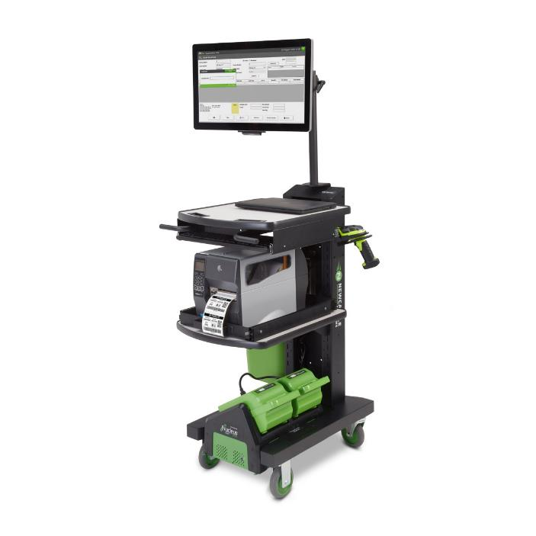

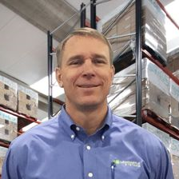
Mobile Power 101:
Configure a Cart with Confidence
Christine Wheeler Marketing Director
Kevin Ledversis Sales Director
November 12, 2020, 2pm

Slide 2

1
Our Goals for Today
2
Why Companies Buy Carts
3
Where to Find Opportunities
4
4 Steps to Configure a Cart with Confidence
5
And.. Quote with Strong ROI Data to Seal the Deal
6
Your Questions

Slide 3
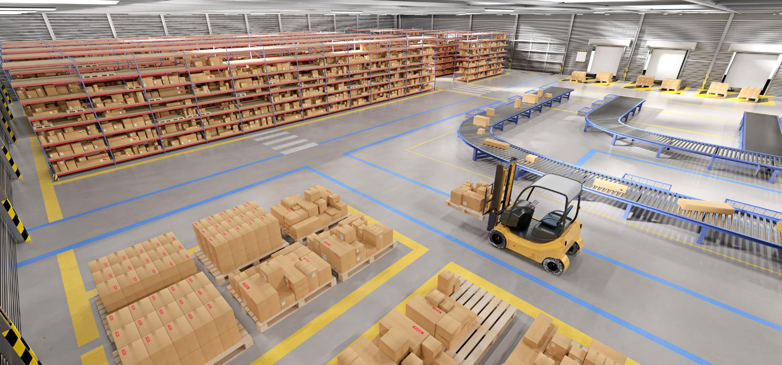
Quick Stats
91% of supply chain professionals cannot stay ahead of their challenges as complexities continue to grow.
46% say meeting consumer expectations for speed, cost and adaptability is the biggest challenge.
Notes:
People aren’t aware they have inefficient print processes because they have worked for them for 30 years without much change
The CHANGE required of us is to move from focusing on the TECHNOLOGY (“Here’s why you need to replace your printer even though it is working fine for you” ) to focusing on PROCESS – where you show them how the process is costing them money and a powered cart can be the solution with the CURRENT printer or with a NEW one.

Slide 4

POLL Question I

Slide 5



3 “Why’s” Companies Buy Carts
Capacity
Lines Received/Put-away 50 lines 8 lines
Speed
Internal Order Cycle Time 2 Hrs > 35 Hrs
Dock to Stock Time 2 Hrs > 24 Hrs
Accuracy
Orders shipped with correct doc’s 99.9% < 95%
Notes:
People aren’t aware they have inefficient print processes because they have worked for them for 30 years without much change
The CHANGE required of us is to move from focusing on the TECHNOLOGY (“Here’s why you need to replace your printer even though it is working fine for you” ) to focusing on PROCESS – where you show them how the process is costing them money and a powered cart can be the solution with the CURRENT printer or with a NEW one.

Slide 6
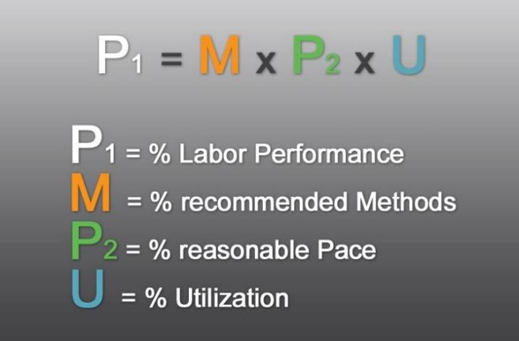
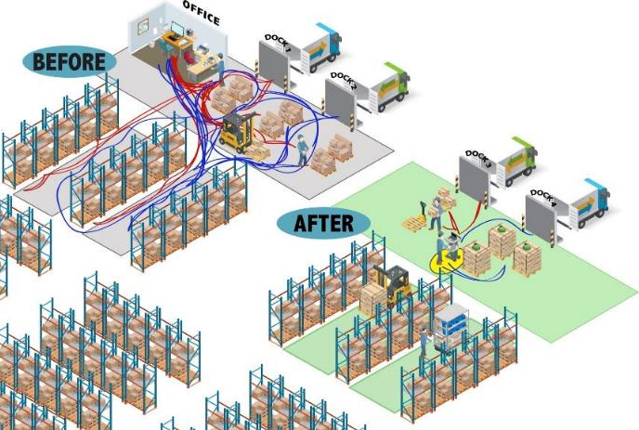
Root Cause
A simple solution to a very complex costly problem
Notes:
People aren’t aware they have inefficient print processes because they have worked for them for 30 years without much change
The CHANGE required of us is to move from focusing on the TECHNOLOGY (“Here’s why you need to replace your printer even though it is working fine for you” ) to focusing on PROCESS – where you show them how the process is costing them money and a powered cart can be the solution with the CURRENT printer or with a NEW one.

Slide 7

WHO Sources for Carts?
Operations
DNA: Results, ROI, Ease of Use
IT
DNA: Ease of Integration, Battery Life, Upgrades
Industrial Engineering
DNA: Process Improvement, Time Savings, Metrics
Notes:
People aren’t aware they have inefficient print processes because they have worked for them for 30 years without much change
The CHANGE required of us is to move from focusing on the TECHNOLOGY (“Here’s why you need to replace your printer even though it is working fine for you” ) to focusing on PROCESS – where you show them how the process is costing them money and a powered cart can be the solution with the CURRENT printer or with a NEW one.

Slide 8
Where Do They Use Carts?
Shipping
Receiving
Manual Pick Carts
Inventory Control
Factory Floor
Notes:
People aren’t aware they have inefficient print processes because they have worked for them for 30 years without much change
The CHANGE required of us is to move from focusing on the TECHNOLOGY (“Here’s why you need to replace your printer even though it is working fine for you” ) to focusing on PROCESS – where you show them how the process is costing them money and a powered cart can be the solution with the CURRENT printer or with a NEW one.

Slide 9
POLL Question II

Slide 10
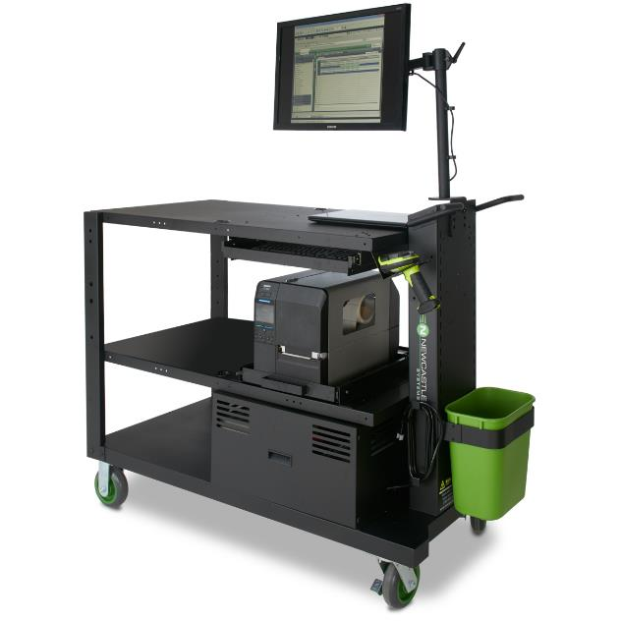
Configure a Cart with Confidence
4 Steps:
Understand their process
What do they want to power?
How long do they need to power it?
Select cart form factor

Slide 11
Step 1 – Understand Current Process
What to Ask…
  Are you labeling product?
  Are your workers walking to enter data or print labels/paper?
  Any idea on travel times? Typically about 10 minutes per hour
  Do you batch print?
  Do you mislabel product?

Slide 12


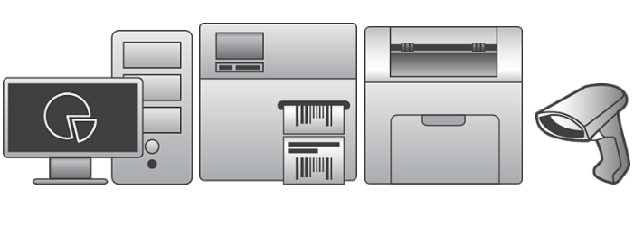
Step 2 - What Do They Want to Power?
Most Popular Hardware:
Laptop & Monitor
Wireless Keyboard/Mouse
Industrial Barcode Printer
Scanner
Compatible Battery Systems:
PowerSwap Nucleus
SLA
Fixed Lithium
Please Note:
Laser printers are power hogs
Compatible Carts:
NB Series & PC Series
Compatible Battery Systems:
SLA & Fixed Lithium
NO PowerSwap Nucleus
with Laser Printers

Slide 13
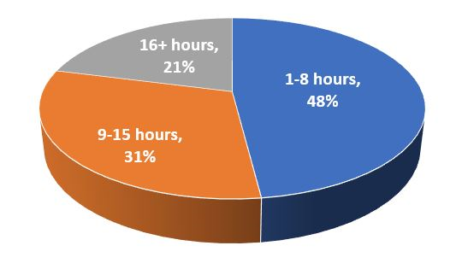
Step 3 – How Long Do They Want to Power It?
8-Hour Shift – MOST popular
Multiple Shifts – PowerSwap Nucleus
Provides 24 / 7 operation

Slide 14
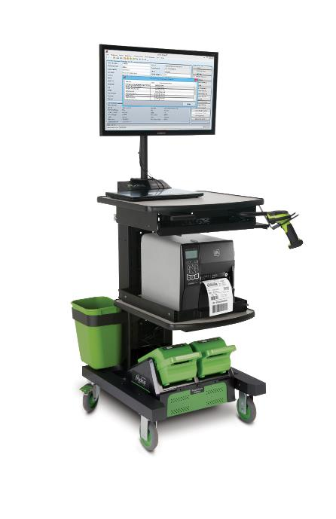
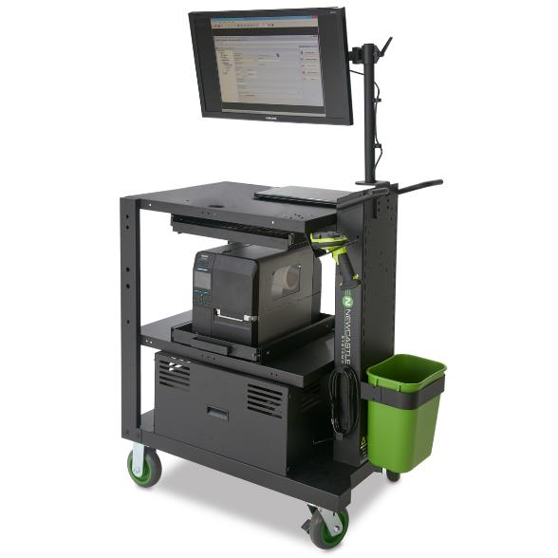
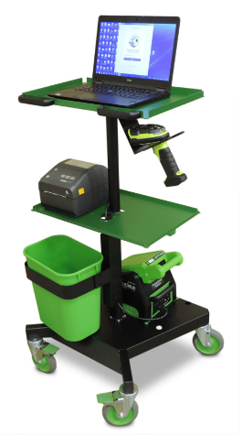
Step 4 – Select Form Factor
Laser Compatible
SLA / Fixed Lithium
-XSmall-
LT Series
-Small-
EC Series
-Medium-
NB Series
-Large-
PC Series

Slide 15

Simple Cheat Sheet
Go to www.newcastlesys.com
Far right corner, click LOGIN
Password: Powersell1

Slide 16
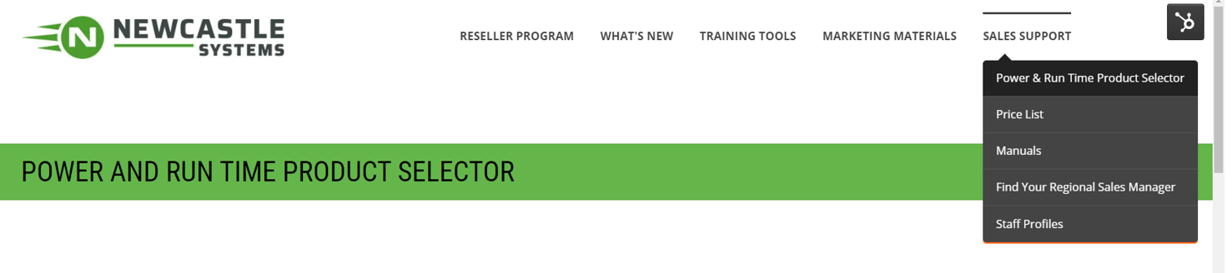
Simple Cheat Sheet

Slide 17
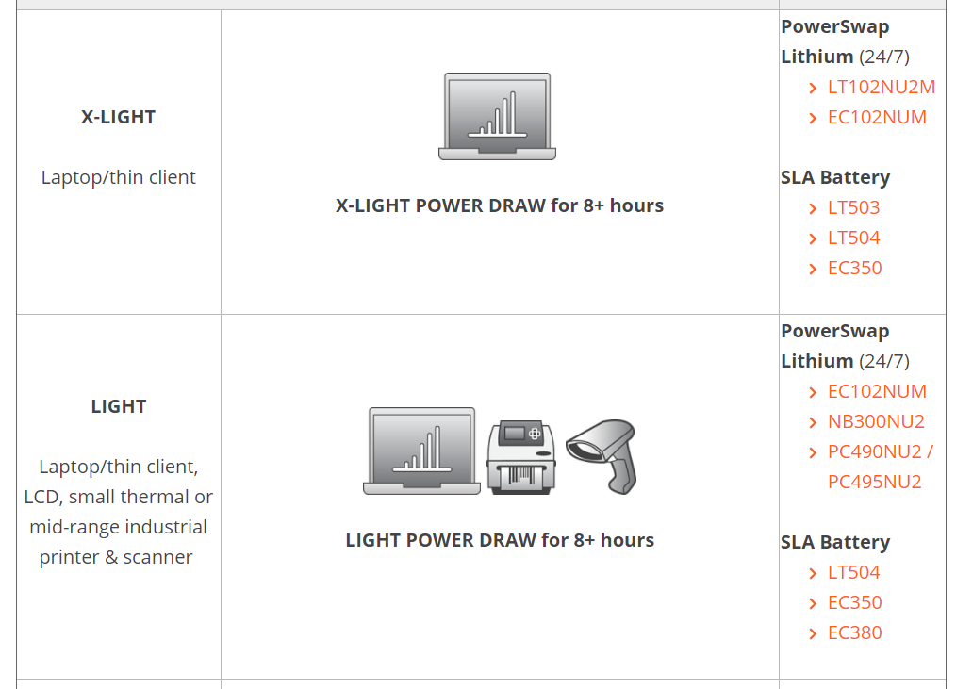
Simple Cheat Sheet

Slide 18
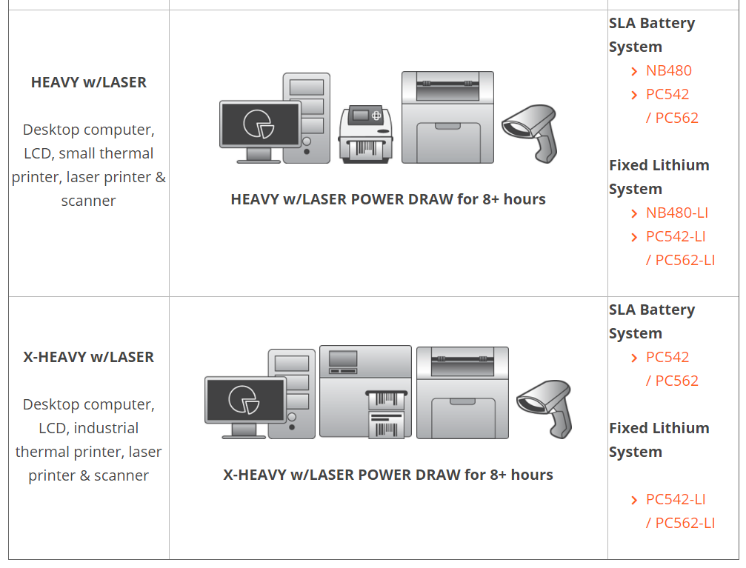
Simple Cheat Sheet

Slide 19
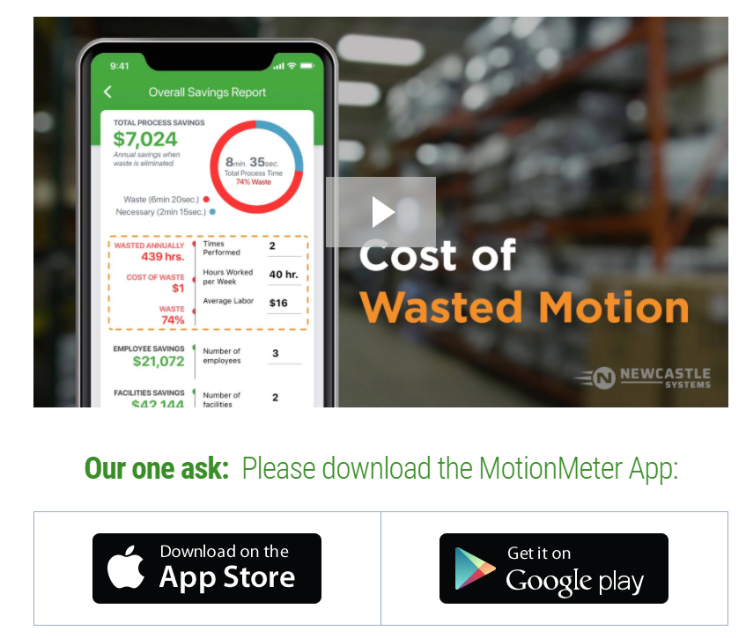
MotionMeter
Easily capture the time
spent walking to printers, computers & more
Notes:
One of the tools we created is the MotionMeter App
Available for Android and Apply Devices
This tool allows you to easily capture and quantify how much wasted motion and any other non-value add tasks, like waiting for labels at shared printer, are costing in labor

Slide 20
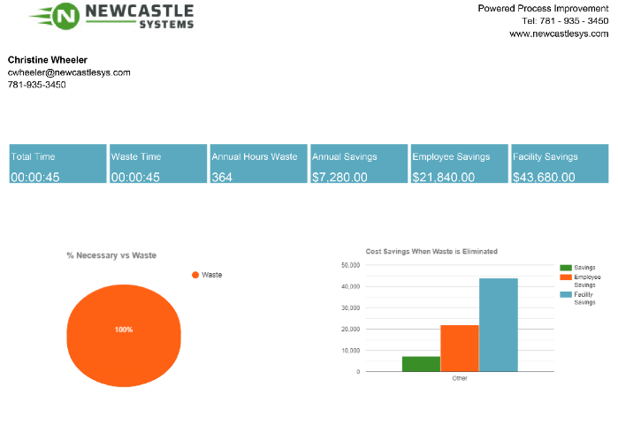
MotionMeter
A formatted PDF arrives in your Inbox...
Notes:
PDF Report sent from App you can share with Prospect

Slide 21
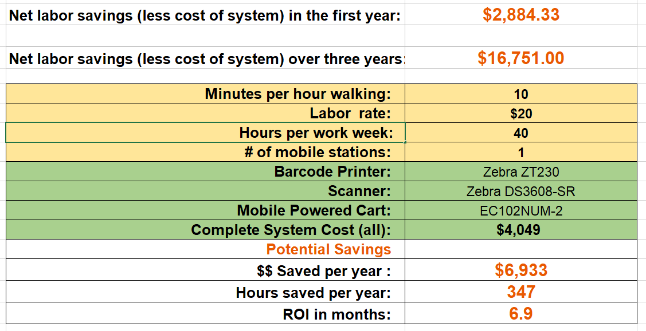
Raise Eyebrows – Show Them the Math

Slide 22
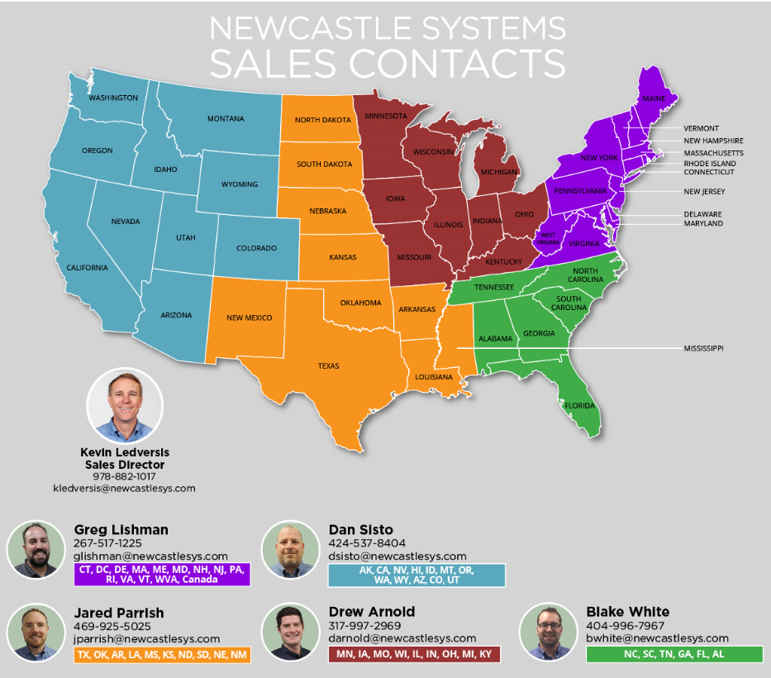

Slide 23
Your Questions

Slide 24


